Slide 1
Steganography Using S-Tools

Slide 2
Understanding Steganography in Graphics Files

Slide 3
Steganography definition
Steganography hides information inside another file
Insertion
substitution

Slide 4
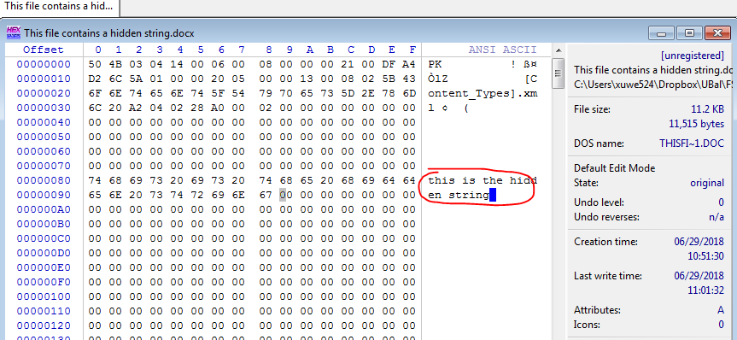
Insertion

Slide 5


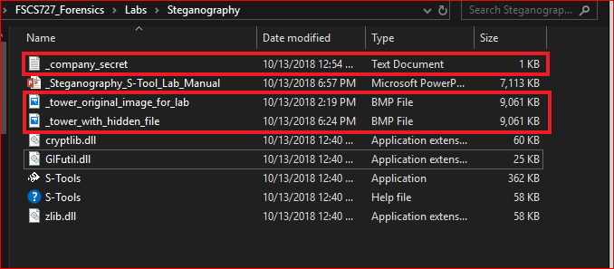
Substitution
Replaces bits of the host file with other bits of data
Original image
Image with a secret file

Slide 6
Substitution
Often use BMP(bitmaps) image
Replaces bits of the host file with other bits of data
Usually change the last two LSBs (least significant bit)

Slide 7
Substitution details

Slide 8

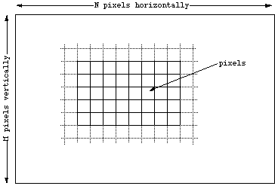
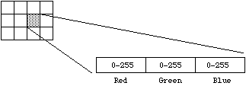
Bitmaps

Slide 9
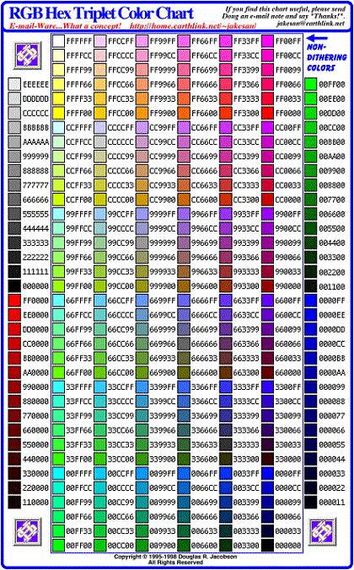
24 bit RGB

Slide 10
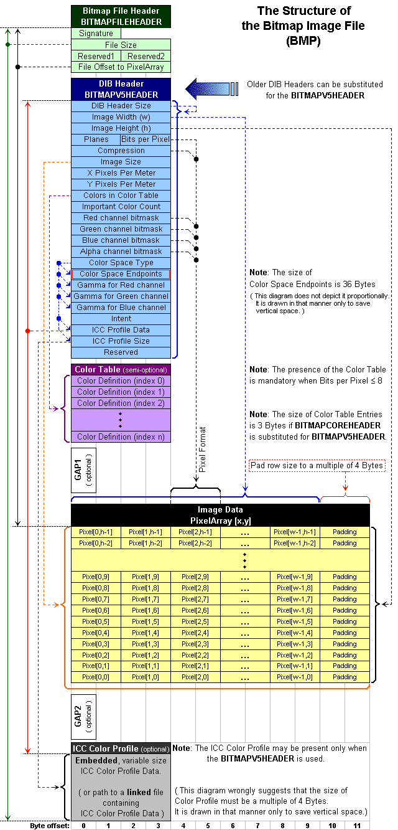

Slide 11
 | Bit breakdown of a secret message
Original Pixel | Altered Pixel
1010 10 10 | 1010 10 01
1001 11 01 | 1001 11 10
1111 00 00 | 1111 00 11
0011 11 11 | 0011 11 00

Slide 12
Verify all the required files for the lab

Slide 13
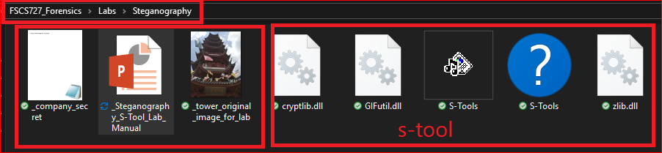
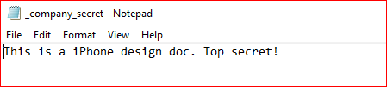

Slide 14

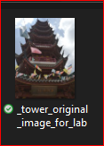
The lab goal
Hide (embed) the text file (company -secret.txt) in the image.

Slide 15
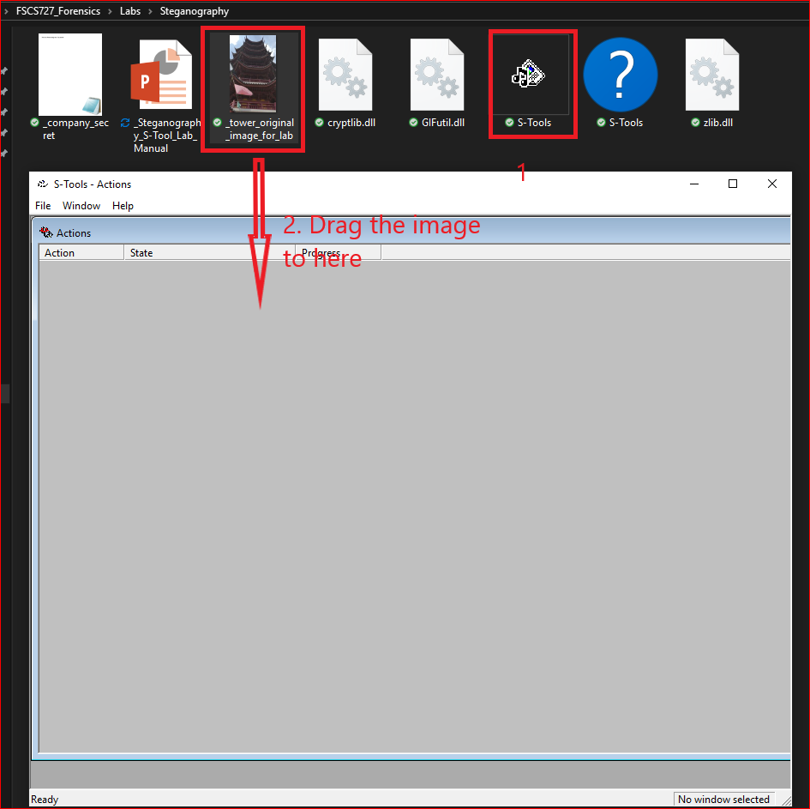
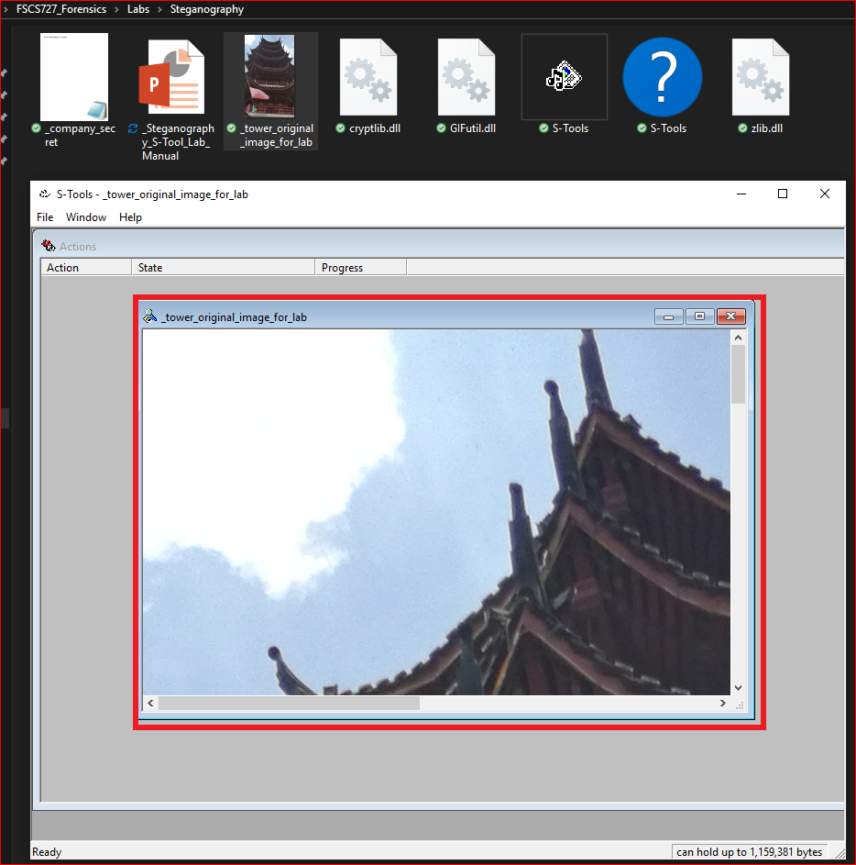

Slide 16
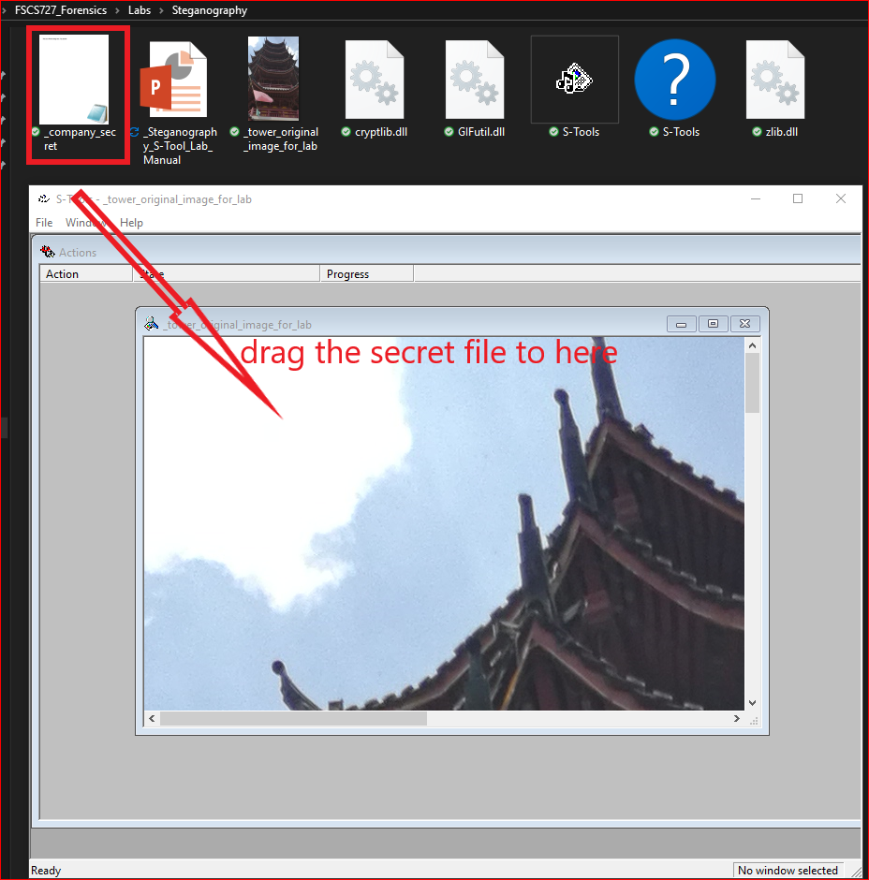
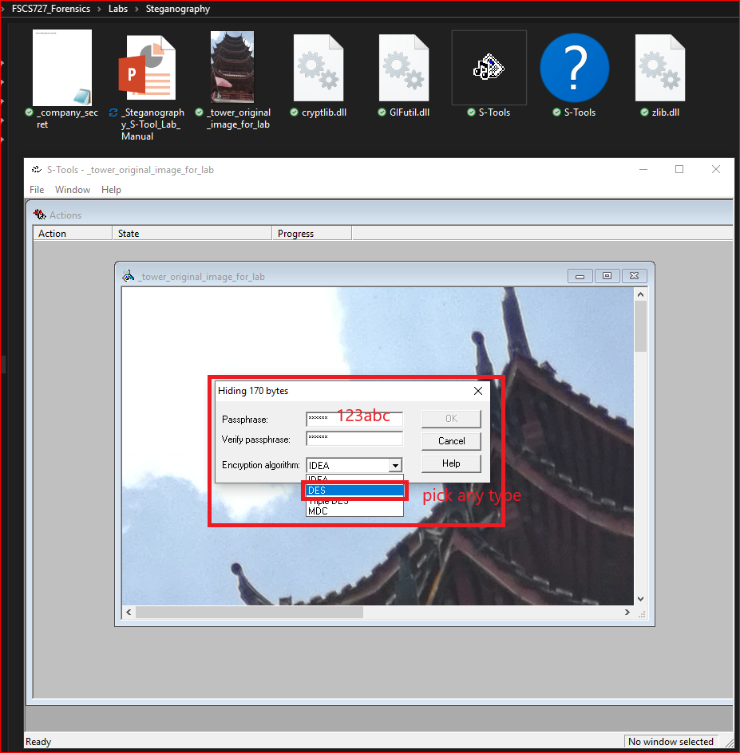

Slide 17
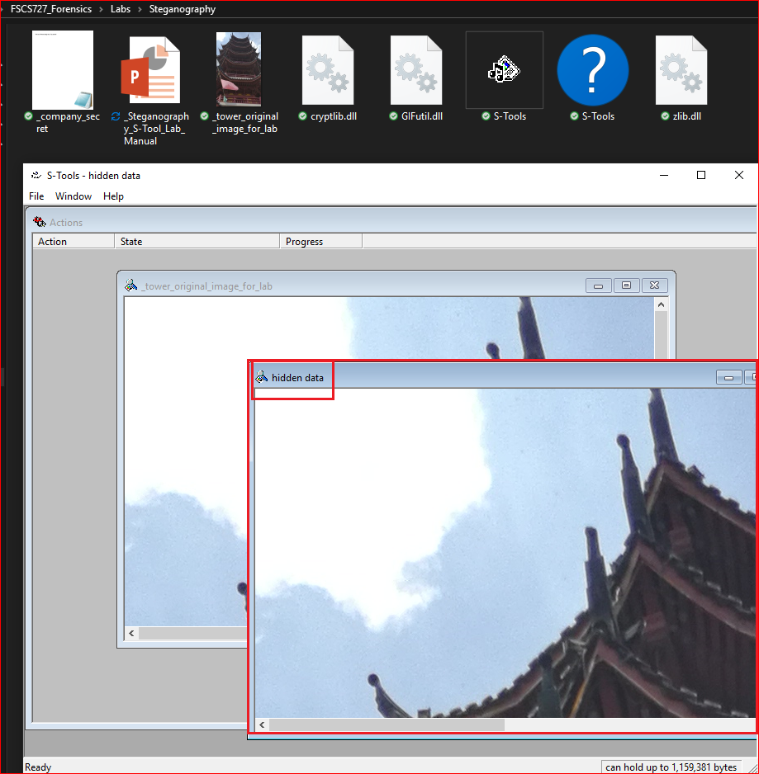
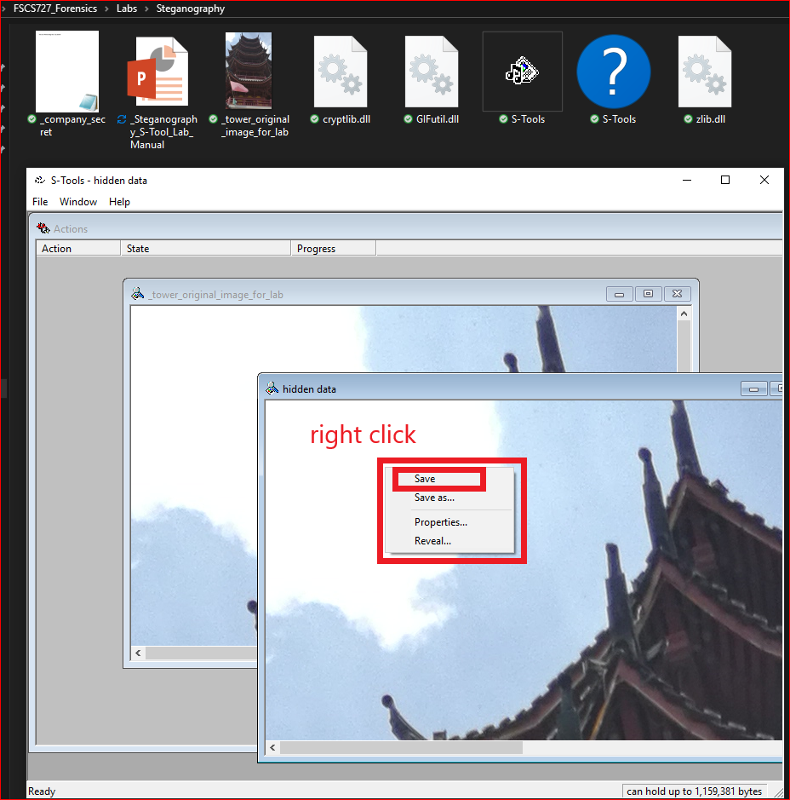

Slide 18
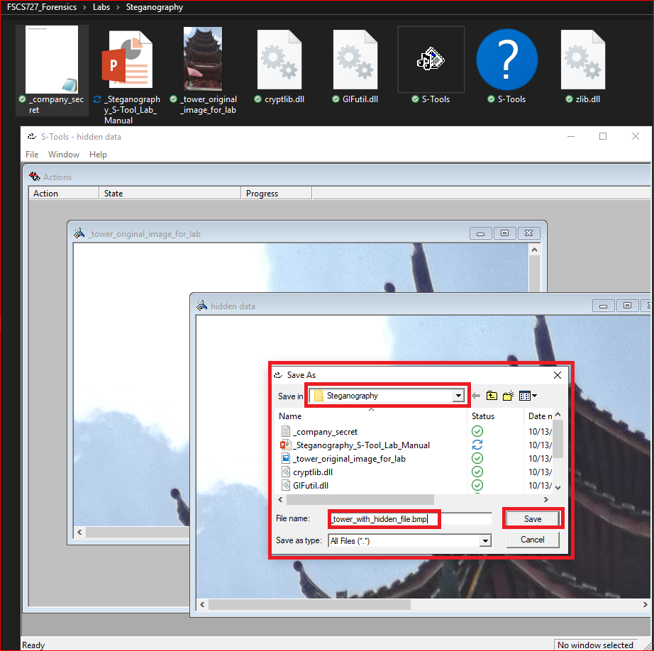
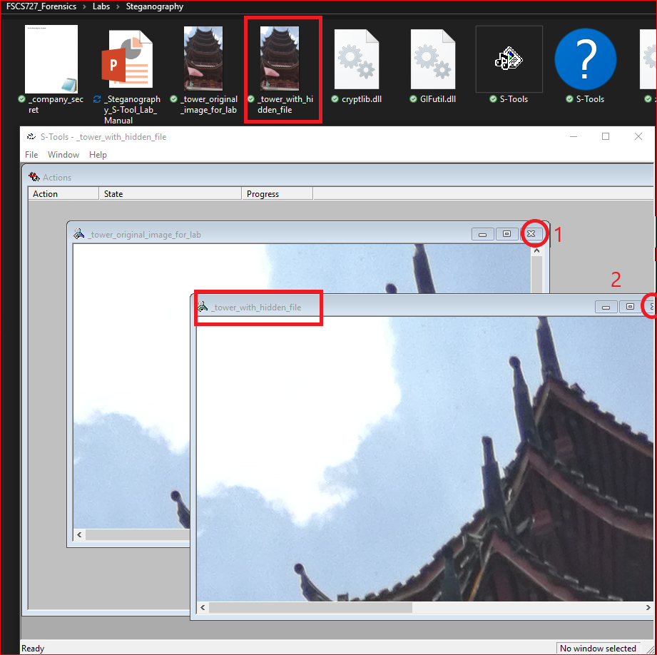

Slide 19
Extract the hidden file from an image

Slide 20
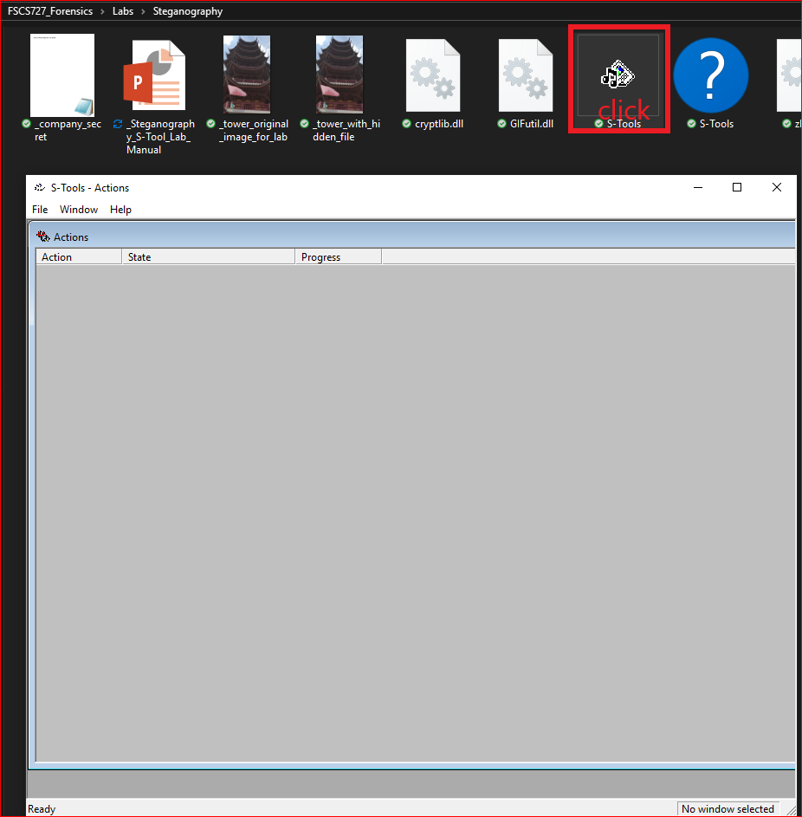
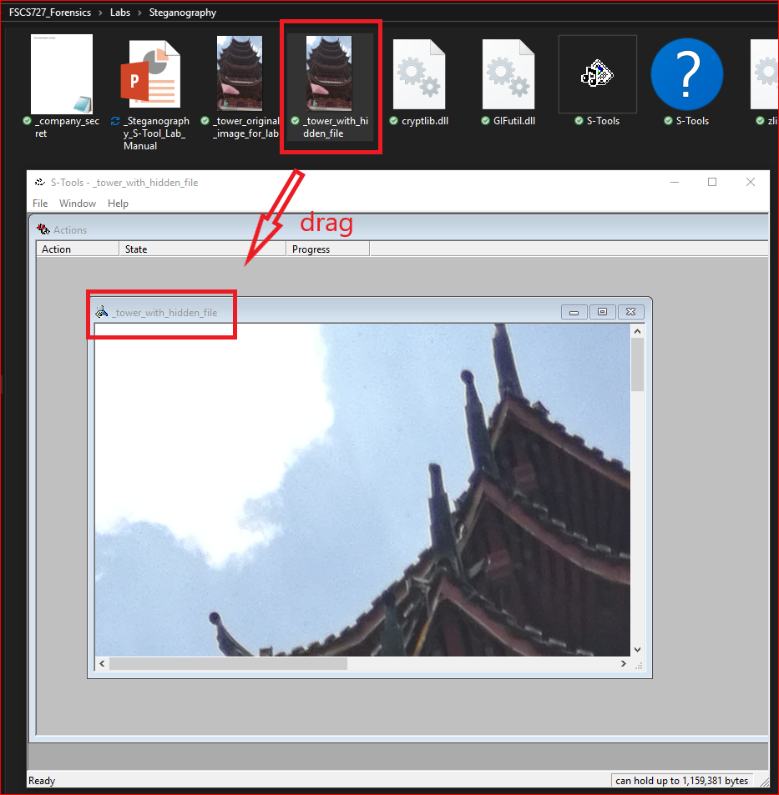

Slide 21
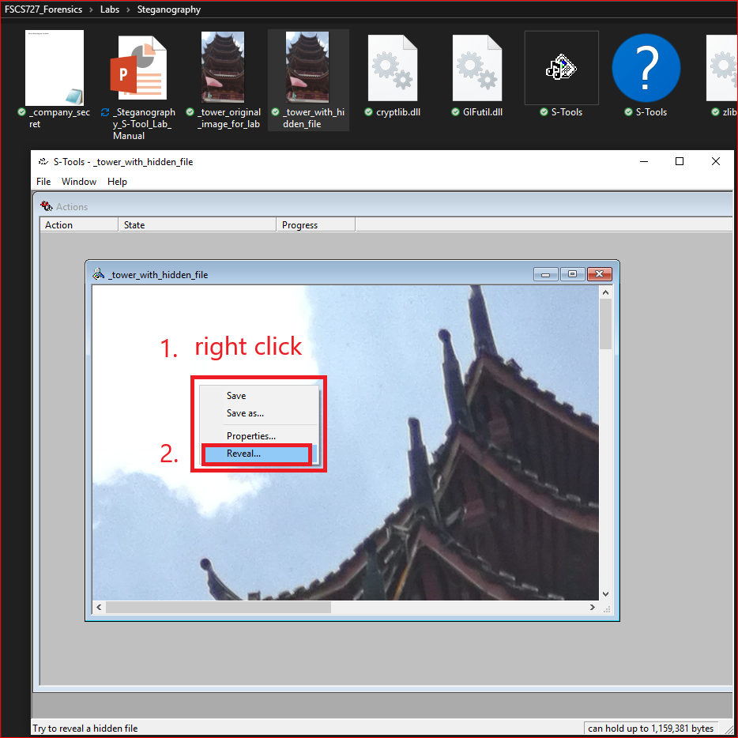
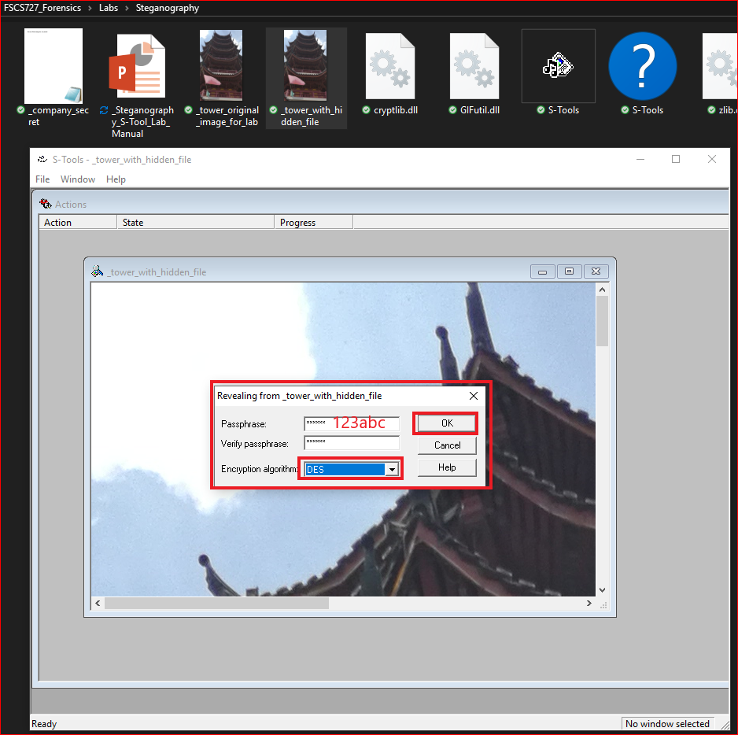

Slide 22
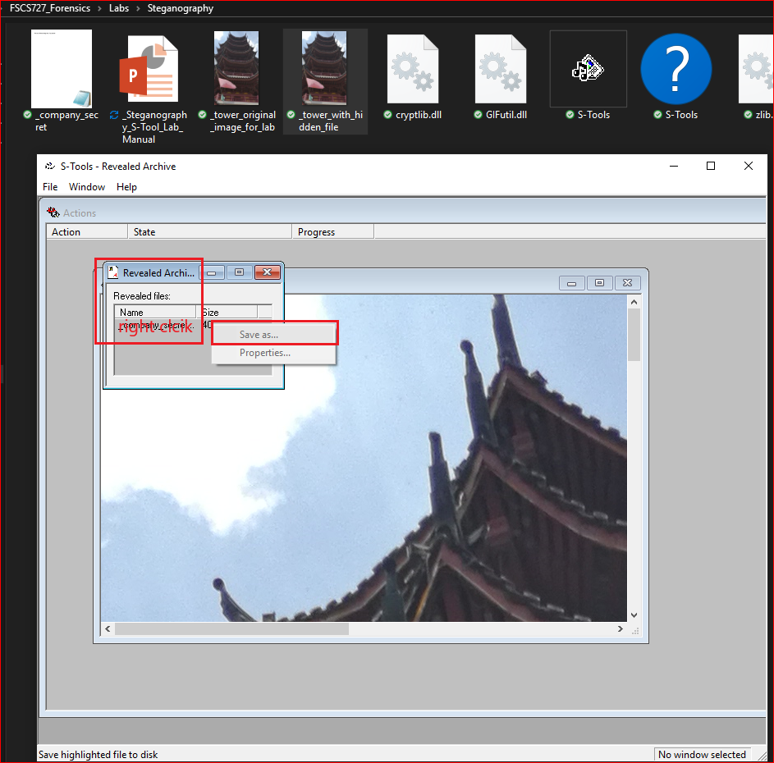
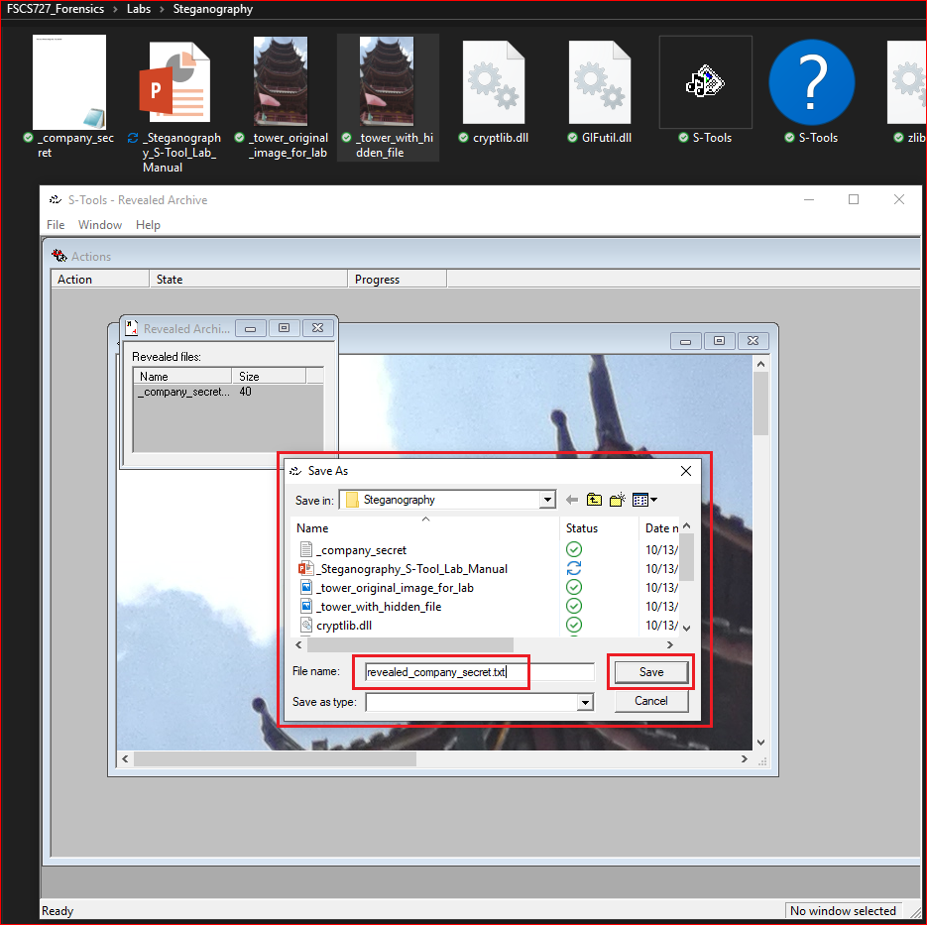

Slide 23
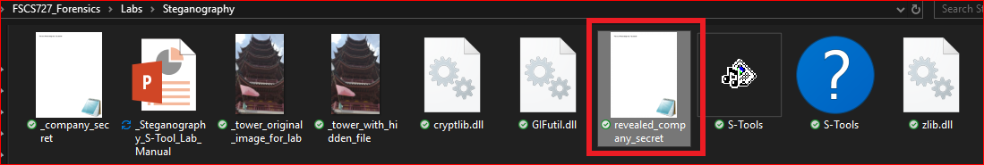
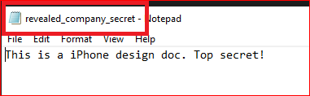

Slide 24
Difference between two image files

Slide 25
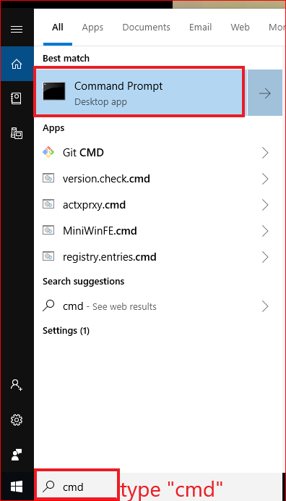

Slide 26
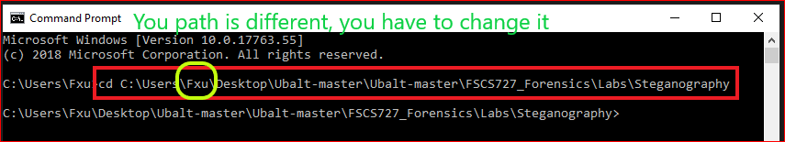
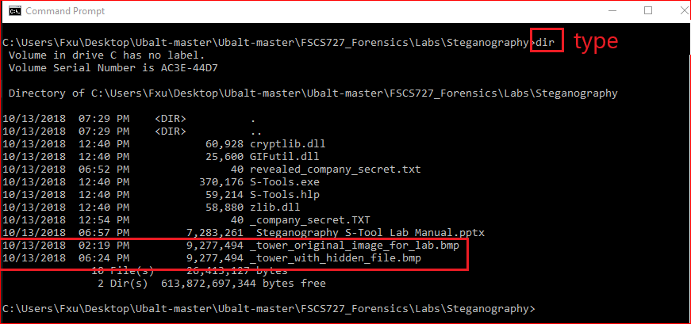

Slide 27
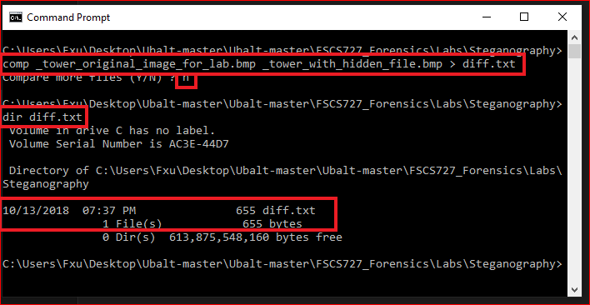

Slide 28
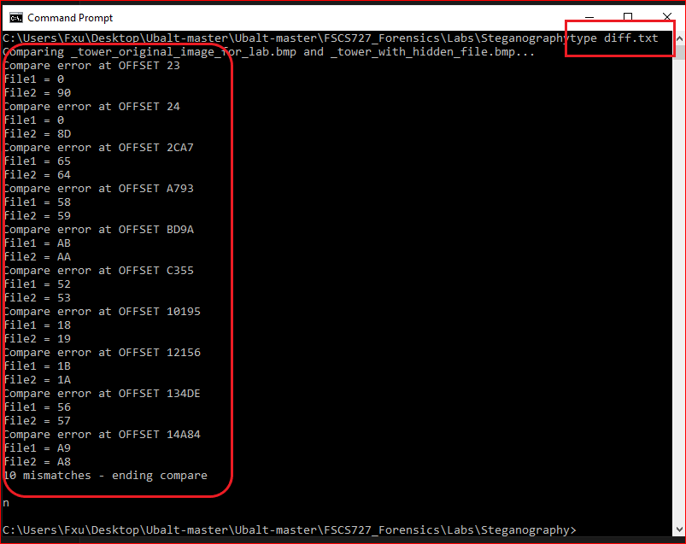

Slide 29
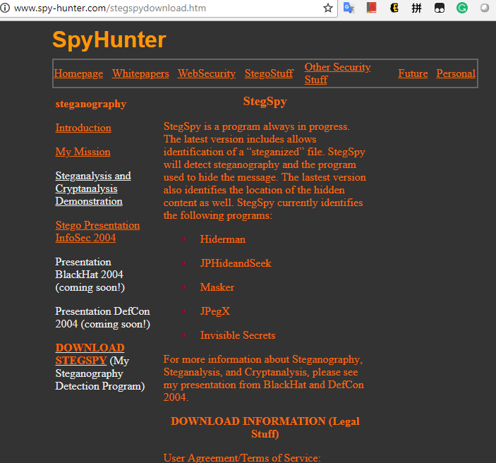
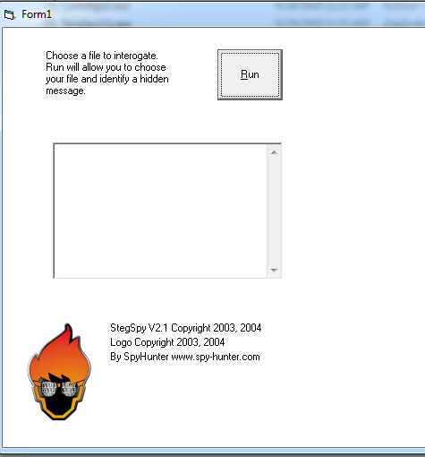
Summary
Use steg tools to detect, decode, and record hidden data
Detect variations of the graphic image
When done correctly you cannot detect hidden data in most cases
Check to see whether the file size, image quality, or file extensions have changed

Slide 30
Reference
http://paulbourke.net/dataformats/bitmaps/

